Slide 1


LOKESH
Team Members
Tirupati Sabath
Karthik Pragada
Kranthi Renam
Ruksana Begum
exhibited By

Slide 2
COMPREHENSIVE DIGITAL MARKETING
TOPIC
FABINDIA

Slide 3

Part 1: Brand study, Competitor Analysis & Buyer’s/Audience’s Persona
Research of Brand Identity:
Brand’s Mission: They will give their customers products that delight them by interpreting their rich heritage and traditional knowledge, while protecting the natural environment.
Brand’s Values: To remain true to their company's history and their founder's original Vision: "In addition to making profits, their aims are constant development of new products, a fair, equitable and helpful relationship with their producers, and the maintenance of quality on which their reputation rests.”
Brand’s Vision: Fabindia links over 55,000 craft based rural producers to modern urban markets, thereby creating a base for skilled, sustainable rural employment, and preserving India's traditional handicrafts in the process.
Brand’s Unique Selling Propositions (USPs): Fabindia is a multi-category store brand, with a unique ethnic and artisanal positioning across fashion, lifestyle, home décor and personal care categories. Established in 1960, the brand is built on artisanal heritage and tradition.

Slide 4

BUYER’S/AUDIENCES PERSONA: Fabindia targets the customer of age group of 18 to 14, who are young professionals, college going students, just married couples have love for Indian culture, traditions and ethnic wear. According to Trait theory, Fab India focuses on people who are:
High on consumer ethnocentrism, i.e. such customers are more rigid and attracted towards their culture.
High in NC (Need for Cognition) are more responsive to product related description and are more responsive to written message, while customers who are low in NC are more influenced with the glamour associated by the product rather than stressing on knowing what actually the product is.
Highly dogmatic since these customers are more likely to prefer traditional alternatives over traditional products.

Slide 5

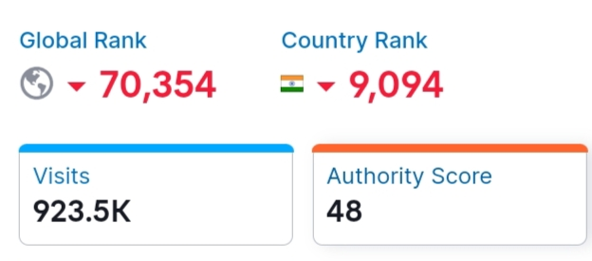
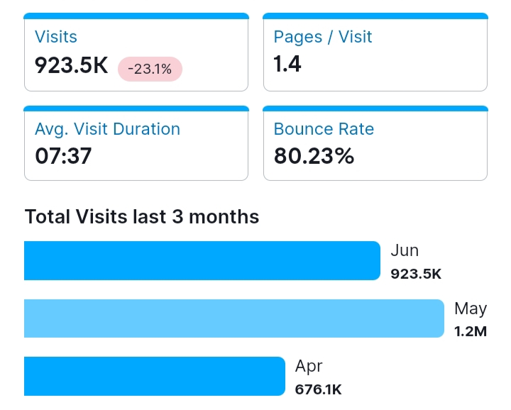
Part 2: Seo & keyword research
SEO Audit of Fabindia Website:

Slide 6

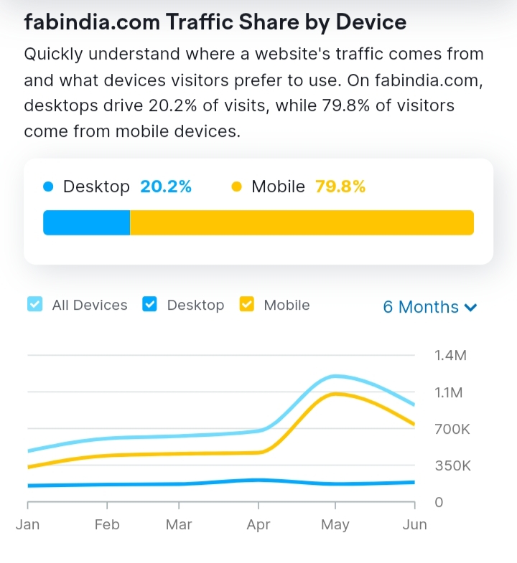
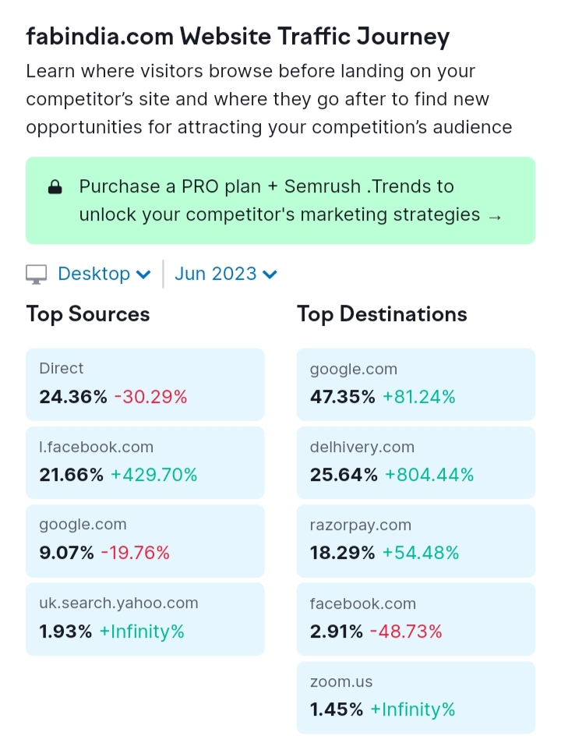
Keyword Research Tools: SEMRUSH

Slide 7

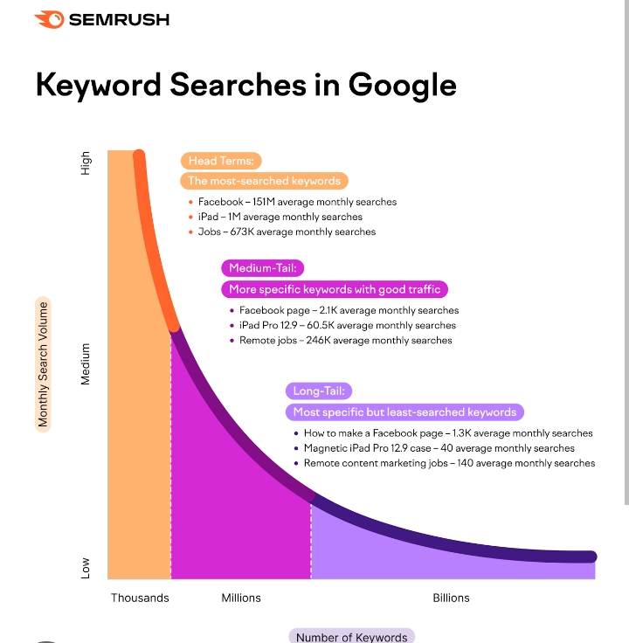

Long-tail Keywords:
For example, if we analyse the keyword “best content marketing podcasts,” we see that it has a low search volume and low keyword difficulty and also have lower competition but higher conversation potentiality which align with the research objectives. It’s also longer and highly specific. So, it’s a long-tail keyword. These are usually keywords closely related to the term you just searched for.

Slide 8

One tag optimization: META TAG OPTIMIZATION Meta tags are HTML tags used to provide additional information about a page to search engines and other clients. Clients process the meta tags and ignore those they don’t support. Meta tags are added to the <head> section of your HTML page and generally look like this: <!
Meta Description for SEO:
Keep it under 160 characters.
Create distinct summaries for each page.
Avoid duplicate meta descriptions on your website.
Use sentence case.
Be accurate, descriptive, and concise.
Match search content.
Only include your target keyword where it makes sense.

Slide 9
Content optimization for SEO: Essentially content optimization, or SEO (search engine optimization) is the process of optimizing your content to make sure that it’s more visible through the web. Search engine robots will rank highly optimized content higher on a search engine page than non-optimized content.
Tips and techniques how to optimize:
Write great content
Keep new content coming
Use headings
Optimize the text
Optimise images
Optimise videos
Stop writing for search engines
Use social media
Keep it clean

Slide 10

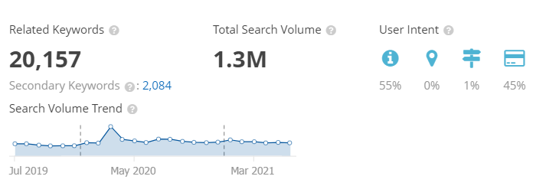

Slide 11

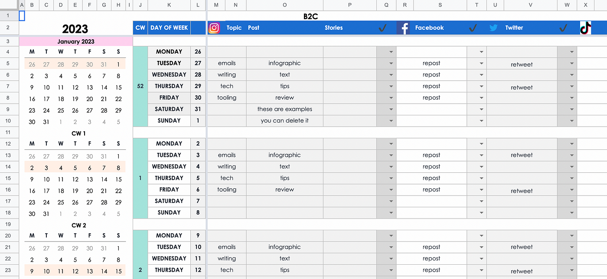

Part 3: Content Ideas and Marketing Strategies CONTENT CALENDAR
JULY

Slide 12

Content, Ideas & Marketing strategies process
Adopt a unique angle with your content. Know Your Audience.
Tap into current trends.
Build evergreen content.
Nurture your email subscribers.
Create original research.
Write your case studies.
Build Interactive Tools.

Slide 13
Challenges encountered and lessons learned in marketing strategies
Recruiting talent.
Maintaining a sufficient budget.
Generating leads. ...
Finding the right tools.
Being risk-averse.
Moving into new markets.
Retaining customers.
Retaining and training staff.
Choosing effective tactics.
Facing increased competition.

Slide 14

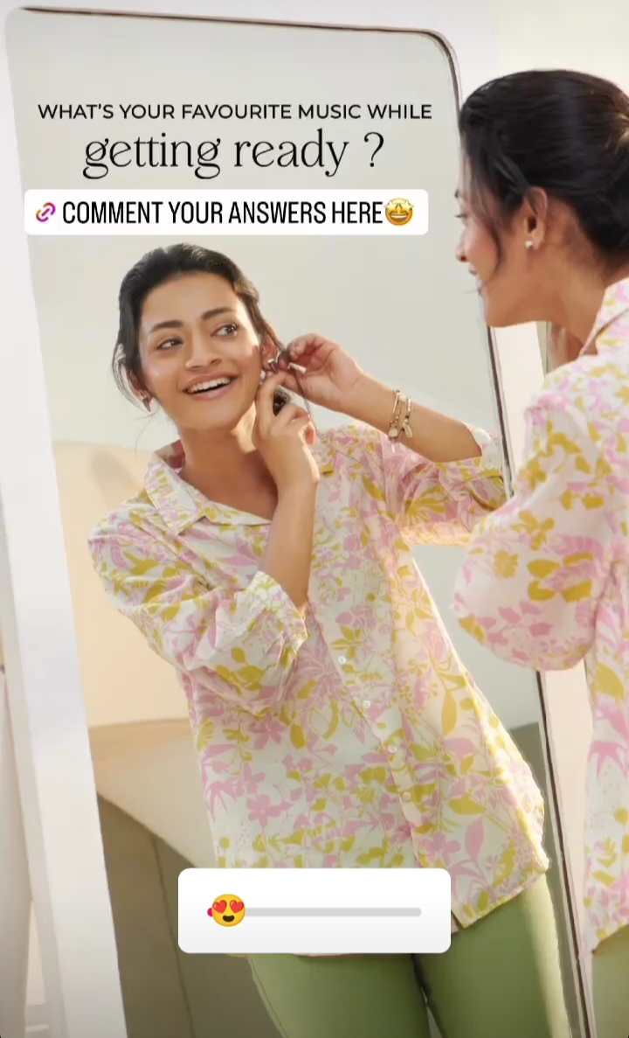

Instagram Story

Slide 15
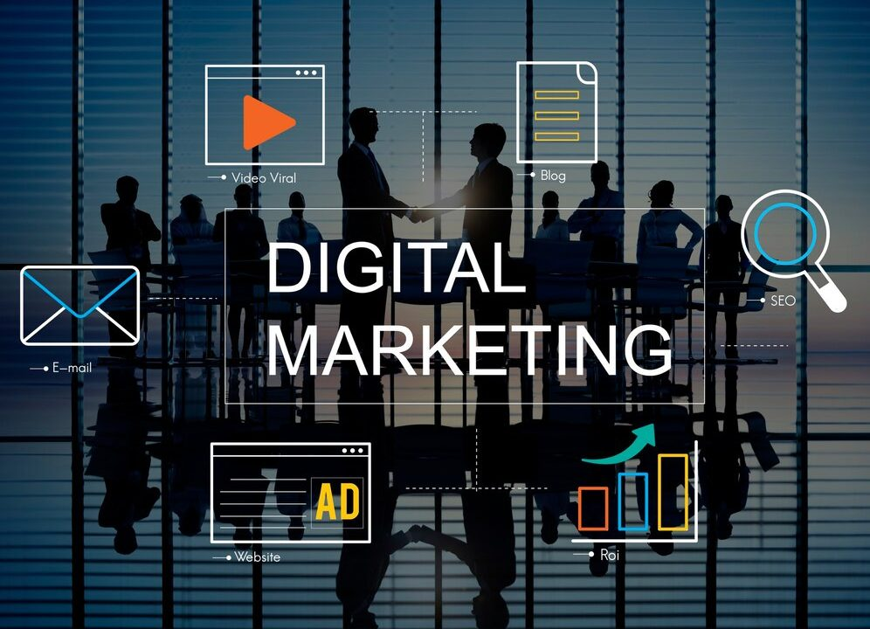
Designs/Video Editing
Tools Familiarization

Slide 16
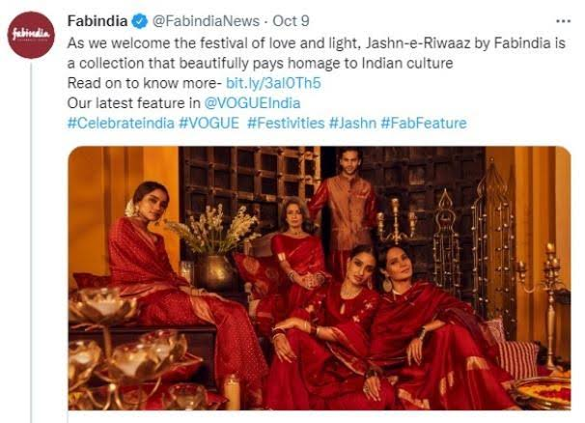
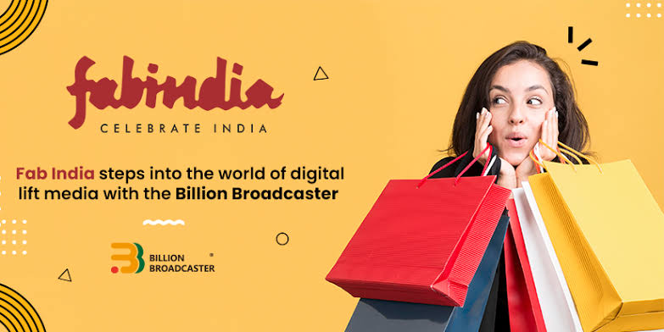
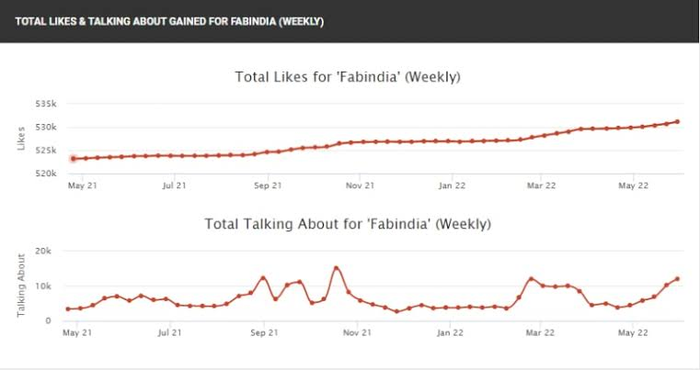
Social Media Ad Campaigns

Slide 17

Advertising Goals. Brand Awareness: Brand awareness refers to the level of familiarity consumers have with a particular brand. It is measured by how well consumers can recognize the brand's logo, name, products, and other assets. Driving website traffic: Website traffic refers to the volume of users visiting a website. How many people visit a website will depend on the website's purpose, the visitors' own goals, and the way in which they discovered the site. Generating leads: Lead generation is the process of generating consumer interest for a product or service with the goal of turning that interest into a sale. In online marketing this typically involves collecting a visitor's contact information (called a “lead”) via a web form.

Slide 18

Email Ad Campaign 1
Brand Awareness

Slide 19
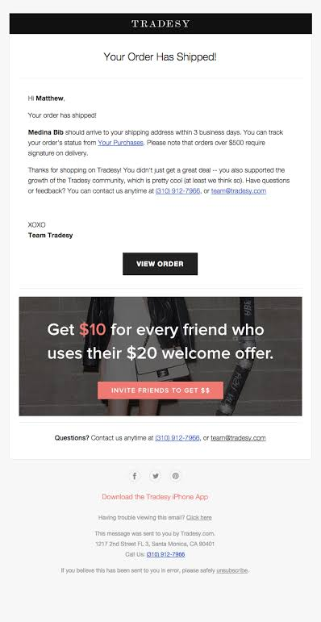
Email Ad Campaign 2
Generation lead

Slide 20
Content Creation and Curation Process Essentially, content curation relates to finding, filtering, and sharing relevant content created by others with your audience. On the other hand, content creation is what it sounds like – creating new content for your audience.
Challenges faced and lessons learned:
Producing high-quality content.
Generating content consistently.
Prioritising content expertise.
Understanding different buyer personas.
Producing content in suitable formats.
Measuring content ROI.
Creating buy-in among stakeholders.

Slide 21


